Slide 1
FOUR STAGES OF DATA VISUALIZATION
Dr Wajid Khan
1

Slide 2
Table of Contents
SECTION I: Data
SECTION II: Data Analysis
SECTION III: Visualization
2

Slide 3
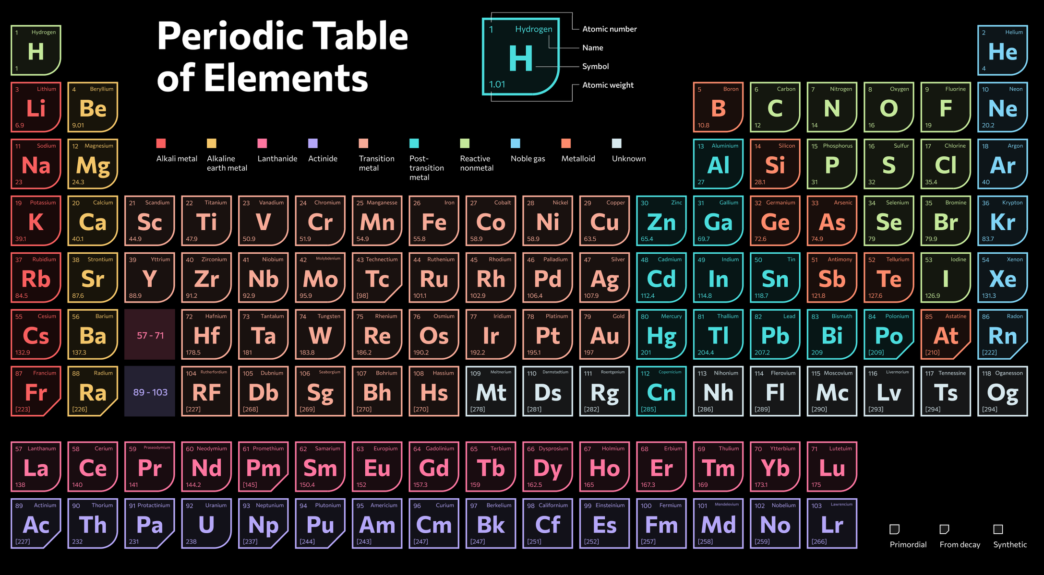
3

Slide 4
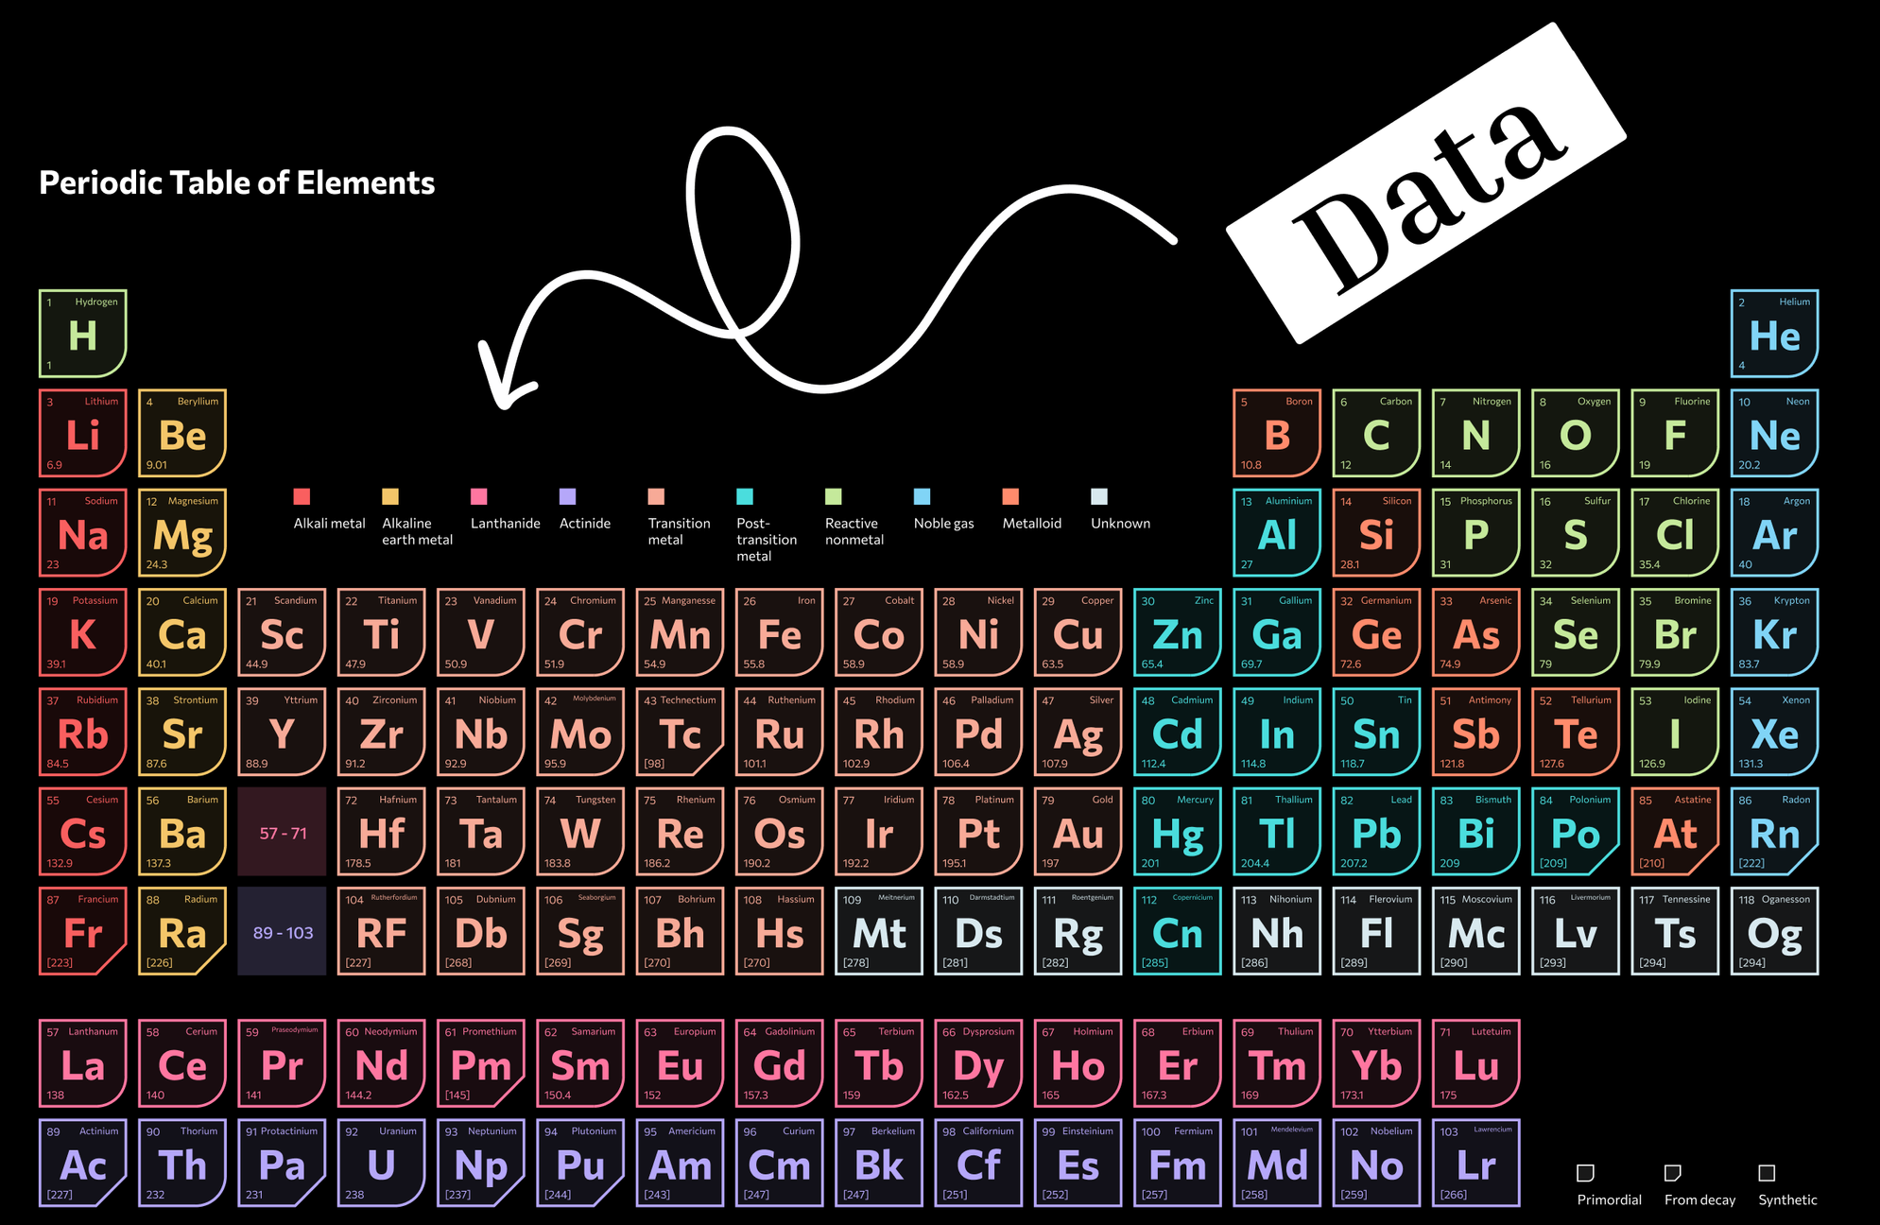
4

Slide 5




Data Vs Earth Elements
Mining
Intrinsic Value
ELEMENTS
Data
Abundance
$500 TRN +
5

Slide 6
DATA ANALYSIS
How it works
6

Slide 7



DATA ANALYSIS
Data problem(s).
Acquisition and processing
Visualization
Retrieval
7

Slide 8


The Seven Stages of Visualization
acquire
parse
filter
mine
represent
refine
interact
7 Stages of Visualizing Data framework, proposed by Ben Fry, cited as Fry, B. (2008)
8

Slide 9
The Seven Stages of Visualization
acquire
parse
filter
mine
represent
refine
interact
I argued in my thesis that the red highlighted stages overlap.
9

Slide 10
The Four Stages of Data Visualization
Acquire and Process
Visualize
Interact
Retrieve
Khan, W. 2014. Thesis: The framework replaces some of Fry’s stages.
10

Slide 11
DATA VISUALIZATION
How it looks
11

Slide 12



Visualization decodes data
Data means nothing
Information adds meaning
Visualization reveals the truth
12

Slide 13

Types of Data Visualization
Fewer than 50 native chart types cover most real-world data needs.
  Comparison – Bar, Line, Column
  Composition – Pie, Donut, Stacked
  Distribution – Histogram, Box, Violin
  Relationship – Scatter, Bubble, Funnel
  Geo/Temporal – Map, Gantt, Calendar
13

Slide 14
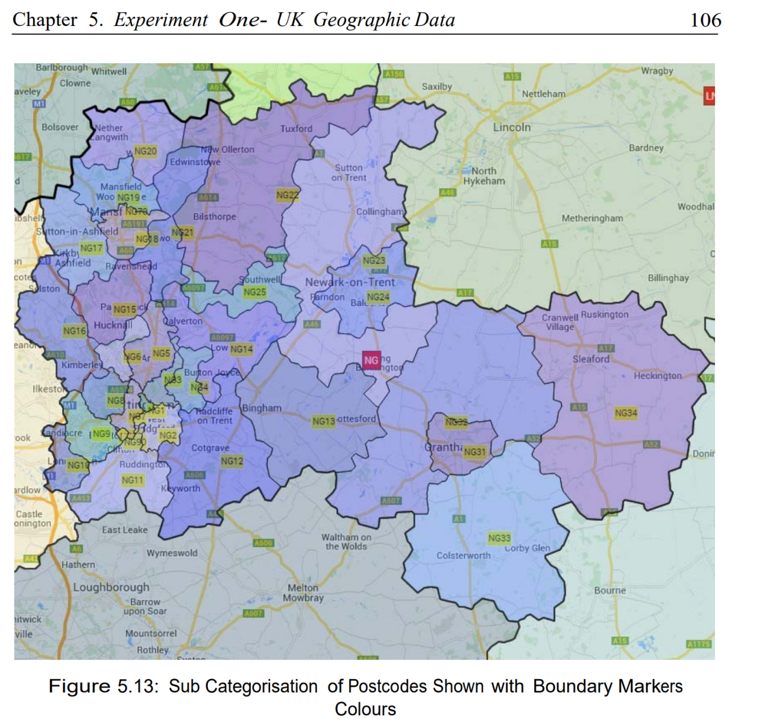
Custom
Visualization
Khan, W. 2014. Academic PhD Thesis: cited from chapter 5.
Using Google Maps and UK postcode data.
Introduce a unique method, ‘linked data visualisation,’ centered on data relations.
14

Slide 15
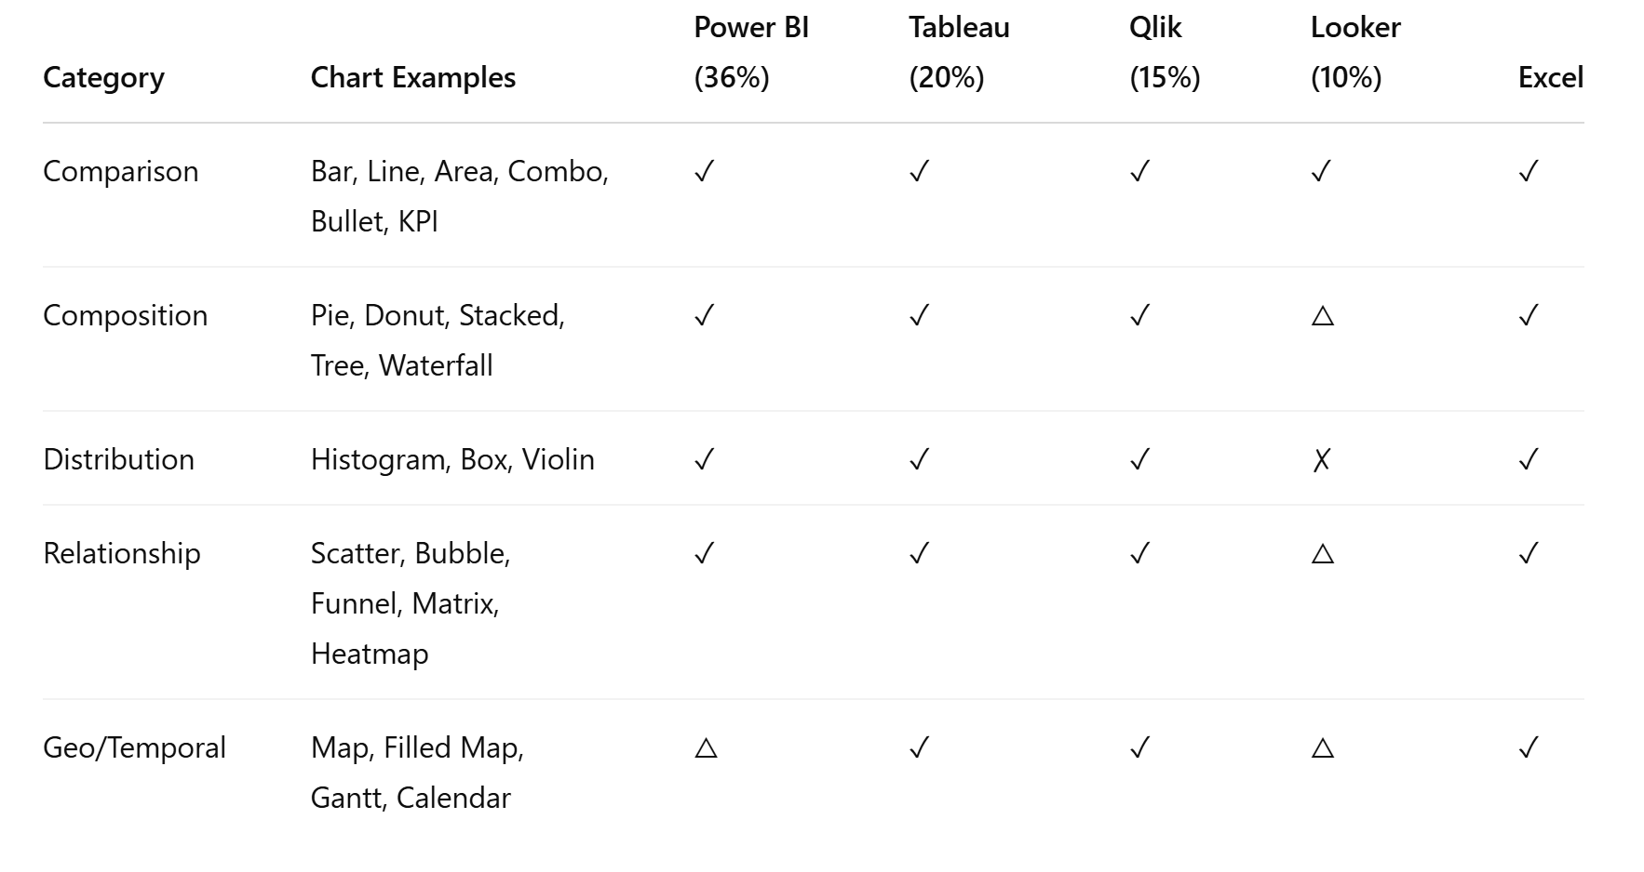
Market Share
15

Slide 16




Summary
AI disruption will continue
AI bots will buy & sell houses
By 2050 ~7% of humans will marry an AI
Data scientists are the key holders of AI
16

Slide 17
Thank You
Dr Wajid Khan
w.khan@tees.ac.uk
me@wajidkhan.info
17

